Slide 1
Intelligent Agent Navigation through Maze using A* Algorithm
Course - Artificial Intelligence Lab
Team Member-
Ripa Rani Biswas(20201001)
Md. Mominul Huque(20201049)
Anowar Hossen Farvez(20201059)

Slide 2


Table Of Contents
1
3
Introduction
Problem Statement
2
4
Sample Input Output
Conclusion
5
Technical Report & Code

Slide 3
Problem Statement
The problem involves navigating through a maze represented as a grid, where each cell can either be empty or contain an obstacle. The agent is allowed to move from one cell to an adjacent cell, considering both cardinal (up, down, left, right) and diagonal directions. However, the agent cannot move to a cell occupied by an obstacle.The agent aims to discover the shortest possible path to the destination cell using the A* search algorithm.

Slide 4
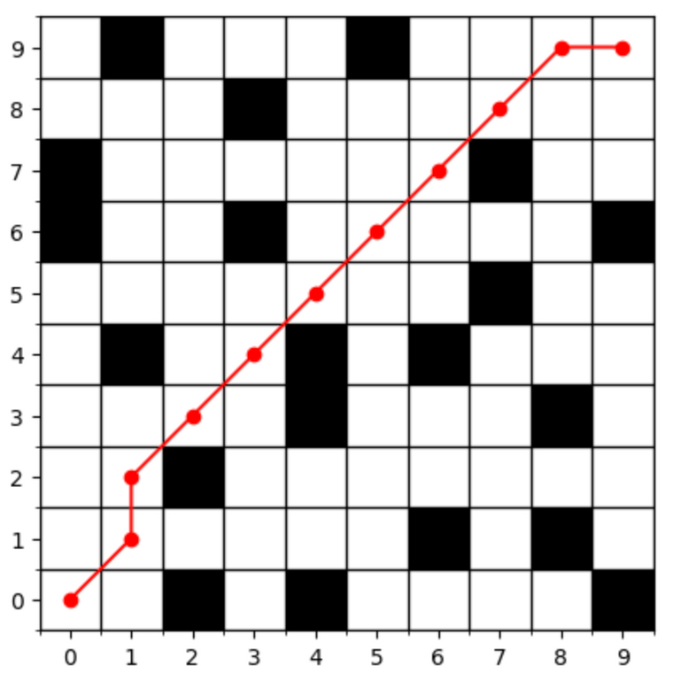
Introduction
Maze navigation is a classic problem in artificial intelligence and robotics, requiring agents to find optimal paths through complex environments. In this project, our agent, starting from a start node cell, aims to reach the goal node while navigating around obstacles. Our focus is on guiding the agent efficiently through the maze using A* algorithm.

Slide 5
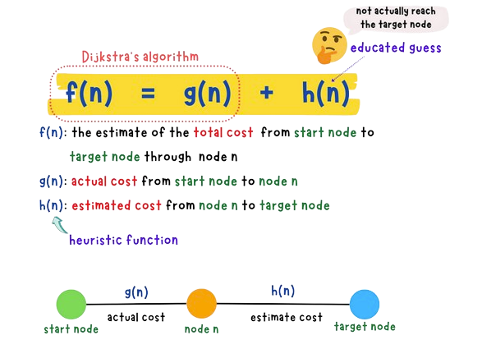
Why A*
A* is a popular and widely used algorithm in computer science, particularly in the fields of artificial intelligence, robotics, and computer games. It can be considered a unique blend of Dijkstra's Algorithm and Greedy Best First Search.

Slide 6
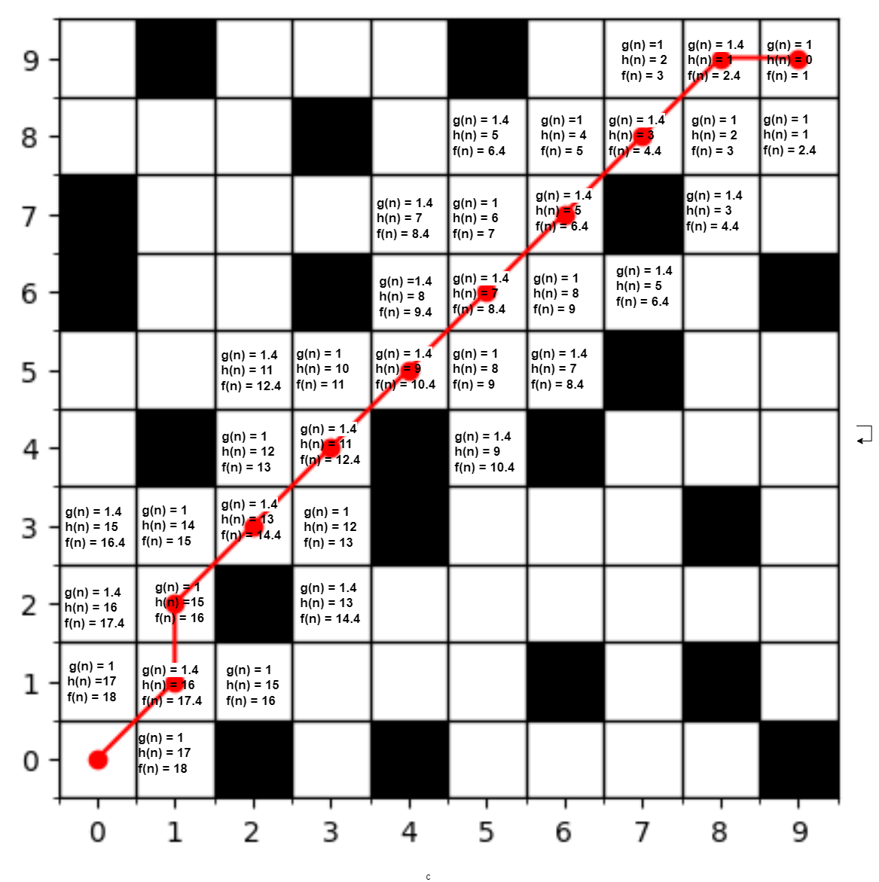
How it works:

Slide 7
Evaluating A* with different Heuristic approaches
We will evaluate the algorithm with two heuristic functions:
Manhattan Distance: The Manhattan distance is essentially the total of the absolute differences between the x and y coordinates of the goal cell and the current cell. Mathematically,
Diagonal Distance: The Diagonal Distance is determined by taking the larger of the absolute differences between the x and y coordinates of the goal cell and the current cell.

Slide 8
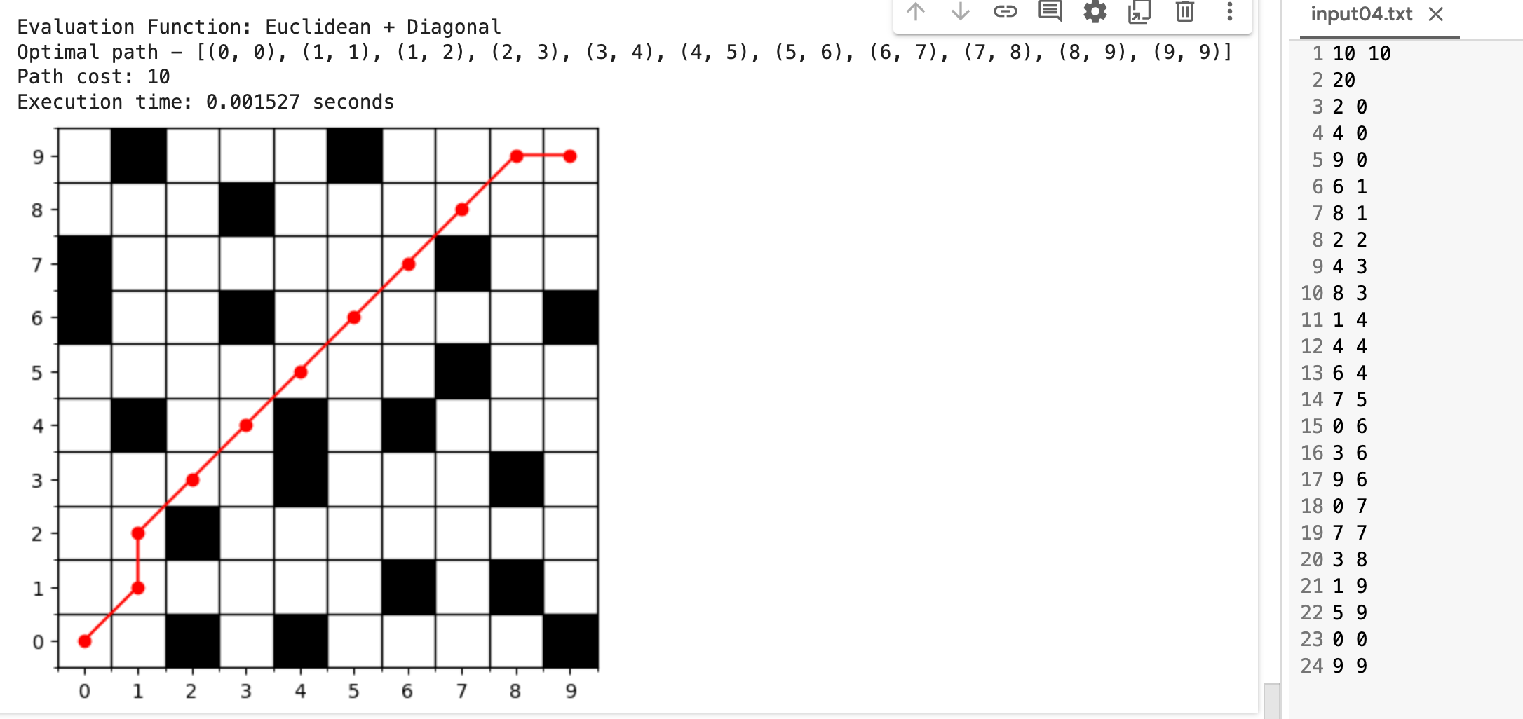
Sample Input Output

Slide 9
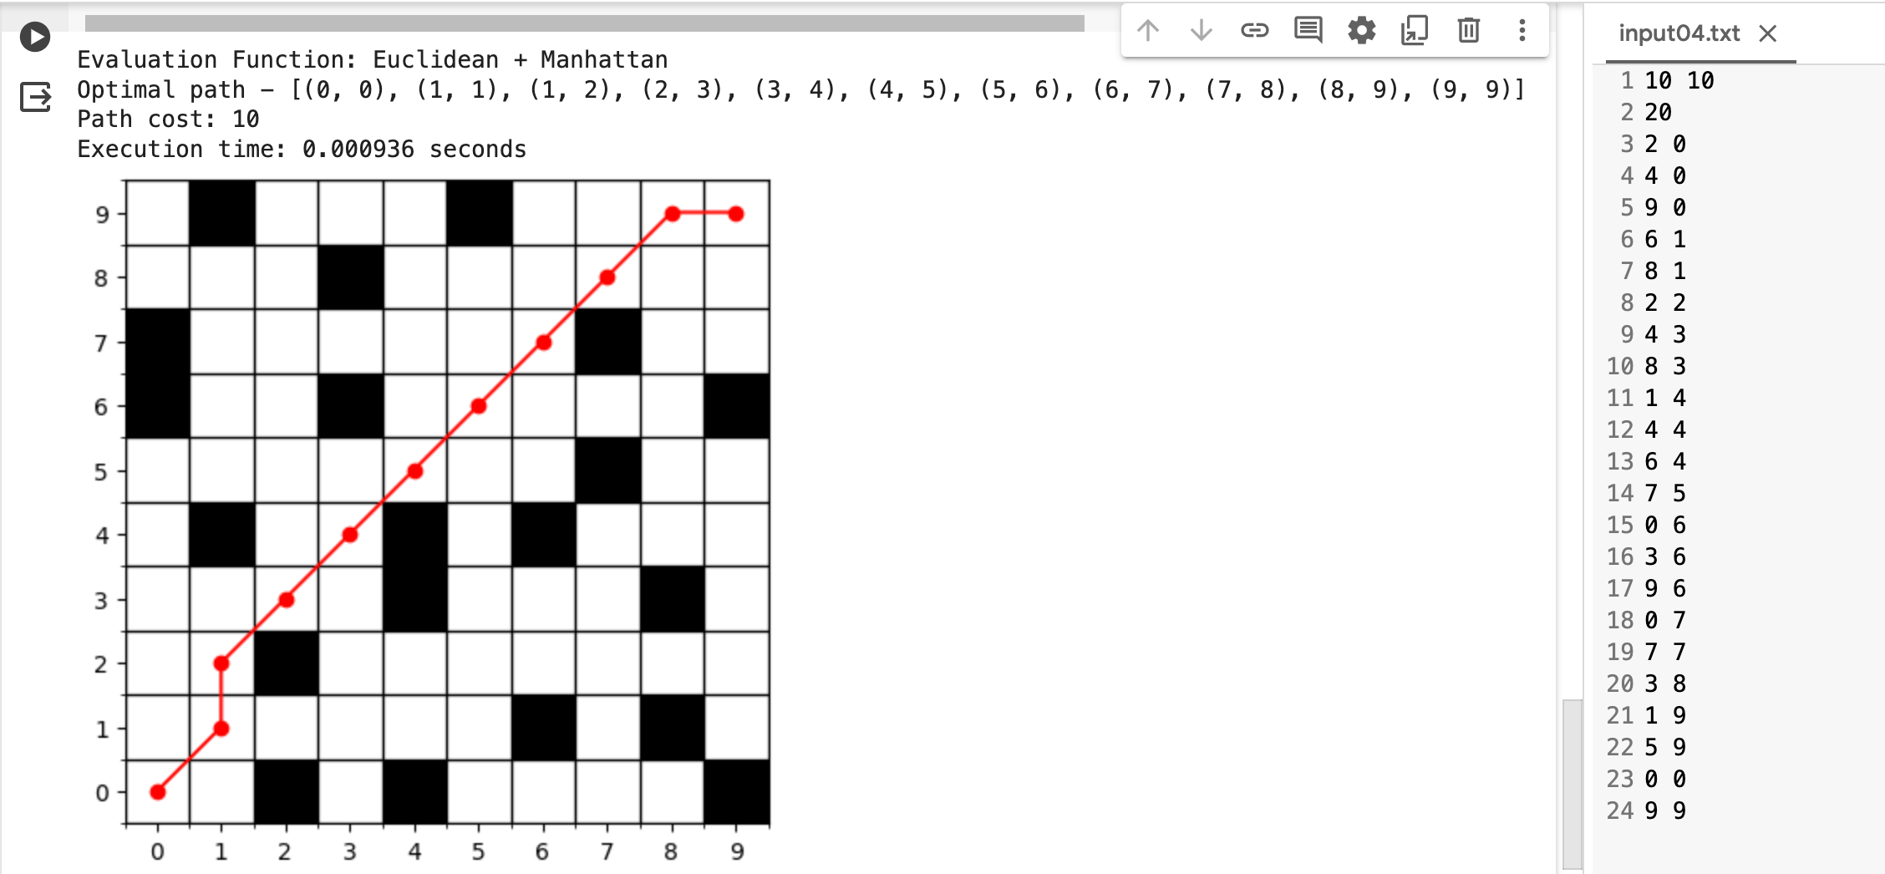
Sample Input Output

Slide 10
Conclusion
We evaluated the A* algorithm for this problem with different heuristic algorithms and it concluded that for this problem the manhattan distance heuristic function has resulted in faster runtime.
By implementing the A* search algorithm, we learned to develop a robust and efficient solution for maze navigation, demonstrating the capabilities of intelligent agents in solving complex pathfinding problems.

Slide 11
Technical Report Link
https://docs.google.com/document/d/1Enp3u-XA6nbURuQKmW3uwANAyiwjyQfl0bCxD4DHs1g/edit?usp=sharing
Code link
https://github.com/capt-farvez/UAP_Academic/blob/main/AI%20Lab/Projects/Astar%20Search/Code/astar_search.py

Slide 12
Thank You!

